Slide 1

CHAPTER 1
INTRODUCTION TO MATLAB

Slide 2
TOPICS
Starting MATLAB
Using MATLAB as a calculator
Creating MATLAB variables
Controlling the appearance of floating point number
Managing the workspace
Entering multiple statements per line
Basic plotting
Multiple data sets in one plot
Matrix generation
Matrix generators
Matrix arithmetic operations
M-File Scripts

Slide 3
The name MATLAB stands for MATrix LABoratory.
MATLAB was written originally to provide easy access to matrix software developed by the LINPACK (linear system package)
and EISPACK (Eigen system package) projects.

Slide 4
MATLAB has many advantages compared to conventional computer languages (e.g. C, FORTRAN) for solving technical problems. MATLAB is an interactive system whose basic data element is an array that does not require dimensioning.
The software package has been commercially available since 1984 and is now considered as a standard tool at most universities and industries worldwide.

Slide 5
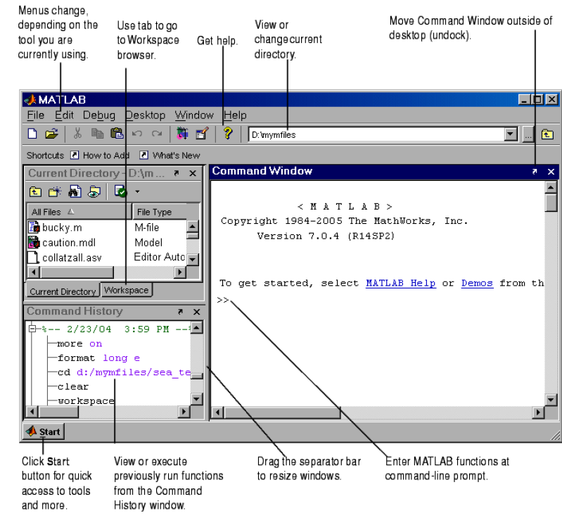
Starting MATLAB
ITCS161

Slide 6
Using MATLAB as a calculator
suppose you want to calculate the expression, 1 + 2 = 3.
You type it at the prompt command (>>) as follows,
>> 1+2*3
ans =
7
Therefore, computing 4x will result in
>> 4*x
ans =
28.0000

Slide 7
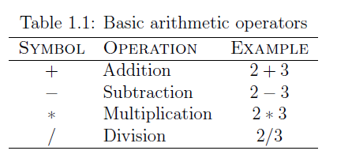

Slide 8
Creating MATLAB variables
variable name = a value (or an expression)
>> t = 5;
>> t = t+1
t =
6
>> x = 10;
>> 5x
??? 5x
|
Error: Unexpected MATLAB expression.

Slide 9
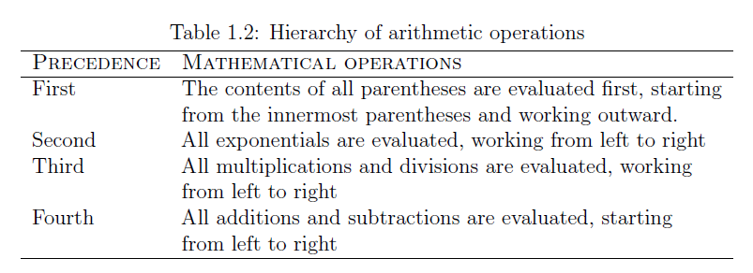

Slide 10
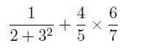
For operators of equal precedence, evaluation is from left to right.
Now, consider another example:
In MATLAB, it becomes
>> 1/(2+3^2)+4/5*6/7
ans =
0.7766
or, if parentheses are missing,
>> 1/2+3^2+4/5*6/7
ans =
10.1857

Slide 11
Controlling the appearance of floating point number
Here are some examples of the different formats together with
the resulting outputs.
>> format short
>> x=-163.6667
If we want to see all 15 digits, we use the command format long
>> format long
>> x= -1.636666666666667e+002

Slide 12
Managing the workspace
>> clear
The command clear or clear all removes all variables from the workspace. This
frees up system memory. In order to display a list of the variables currently in the memory,
type
>> who
while, whos will give more details which include size, space allocation, and class of the
variables.

Slide 13
Entering multiple statements per line
It is possible to enter multiple statements per line. Use commas (,) or semicolons (;) to
enter more than one statement at once. Commas (,) allow multiple statements per line
without suppressing output.
>> a=7; b=cos(a), c=cosh(a)
b =
0.6570
c =
548.3170

Slide 14
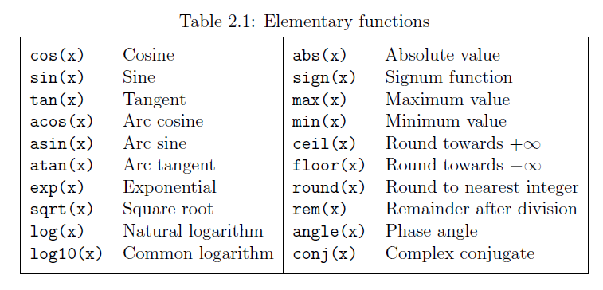

Slide 15
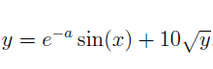
Examples
the value of the expression
for a = 5, x = 2, and y = 8
is computed by
>> a = 5; x = 2; y = 8;
>> y = exp(-a)*sin(x)+10*sqrt(y)
y =
28.2904

Slide 16
Note the difference between the natural logarithm log(x) and the decimal logarithm (base10) log10(x).
>> log(142)
ans =
4.9558
>> log10(142)
ans =
2.1523

Slide 17
To calculate sin(π =4) and e¹⁰, we enter the following commands in MATLAB,
>> sin(pi/4)
ans =
0.7071
>> exp(10)
ans =
2.2026e+004

Slide 18
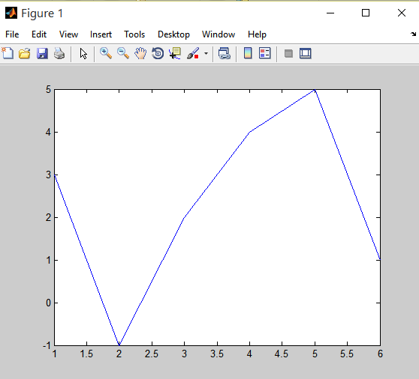
Basic plotting
The MATLAB command to plot a graph is plot(x,y). The vectors x = (1; 2; 3; 4; 5; 6)
and y = (3;¡1; 2; 4; 5; 1) produce the picture shown in Figure 2.1.
>> x = [1 2 3 4 5 6];
>> y = [3 -1 2 4 5 1];
>> plot(x,y)

Slide 19
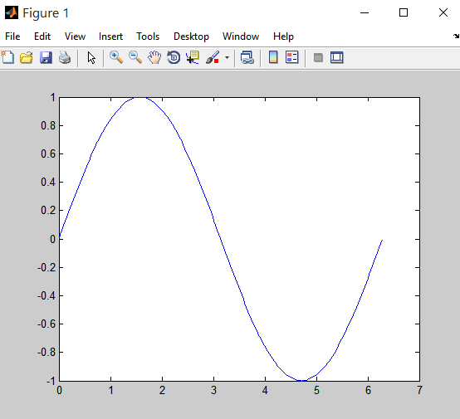
>> x = 0:pi/100:2*pi;
>> y = sin(x);
>> plot(x,y)

Slide 20

>> xlabel('x = 0:2\pi')
>> ylabel('Sine of x')
>> title('Plot of the Sine function')

Slide 21
Multiple data sets in one plot
>> x = 0:pi/100:2*pi;
>> y1 = 2*cos(x);
>> y2 = cos(x);
>> y3 = 0.5*cos(x);
>> plot(x,y1,'--',x,y2,'-',x,y3,':')
>> xlabel('0 \leq x \leq 2\pi')
>> ylabel('Cosine functions')
>> legend('2*cos(x)','cos(x)','0.5*cos(x)')
>> title('Typical example of multiple plots')
>> axis([0 2*pi -3 3])

Slide 22
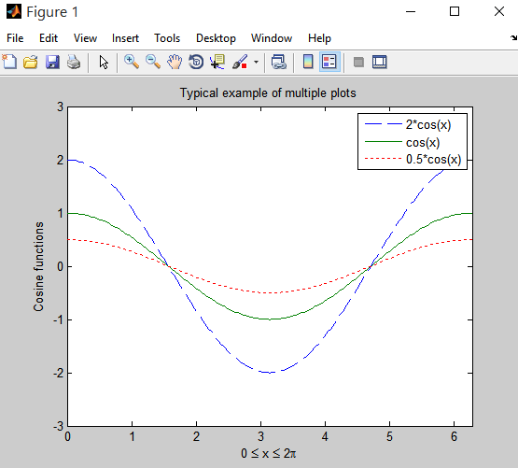

Slide 23
Matrix generation
For example, to enter a row vector, v, type
>> v = [1 4 7 10 13]
v =
1 4 7 10 13
Column vectors are created in a similar way, however, semicolon (;) must separate the
components of a column vector,
>> w = [1;4;7;10;13]
w =
1
4
7
10
13

Slide 24
The transpose operation is denoted by an apostrophe or a single quote (').
>> w = v'
w =
1
4
7
10
13

Slide 25
>> v(1:3)
ans =
1 4 7
Or, all elements from the third through the last elements,
>> v(3,end)
ans =
7 10 13

Slide 26
To enter a matrix A, such as,
1 2 3
A = 4 5 6
7 8 9
type,
>> A = [1 2 3; 4 5 6; 7 8 9]
MATLAB then displays the 3 £ 3 matrix as follows,
A =
1 2 3
4 5 6
7 8 9

Slide 27
A =
1 2 3
4 5 6
7 8 9
>> A(2,1)
ans =
4
>> A(3,3) = 0
A =
1 2 3
4 5 6
7 8 0

Slide 28
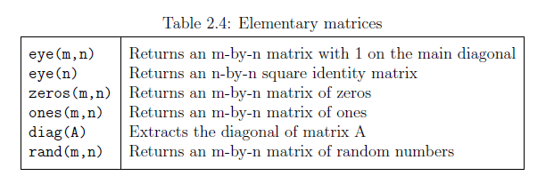
Matrix generators
ITCS161

Slide 29
>> b=ones(3,1)
b =
1
1
1
Equivalently, we can define b as >> b=[1;1;1]

Slide 30
>> eye(3)
ans =
1 0 0
0 1 0
0 0 1
ITCS161
>>c=zeros(2,3)
c =
0 0 0
0 0 0

Slide 31
>> mat = [2:4; 3:5];
>> mat(1,2) = 11
mat = 2 11 4
3 4 5
>> mat = [2:4; 3:5]
mat = 2 3 4
3 4 5
>> mat(2,3)
ans = 5

Slide 32
>> mat = [1:3; 5:7]’
mat = 1 5
2 6
3 7
>> size(mat)
ans = 3 2
>> [r c] = size(mat)
r = 3
c = 2

Slide 33
Matrix arithmetic operations
As we mentioned earlier, MATLAB allows arithmetic operations: +, -, *, and ^ to be carried out on matrices. Thus,
A+B or B+A is valid if A and B are of the same size
A*B is valid if A's number of column equals B's number of rows
A^2 is valid if A is square and equals A*A

Slide 34
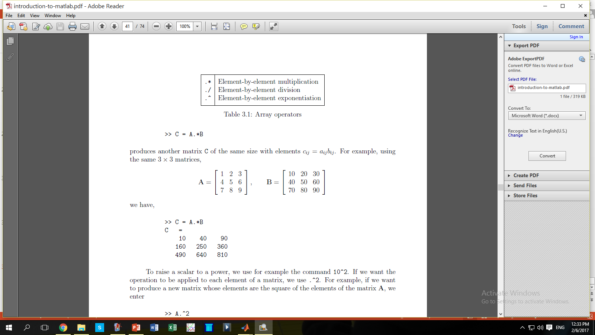
ITCS161

Slide 36
>> A.^2
ans =
1 4 9
16 25 36
49 64 81

Slide 37
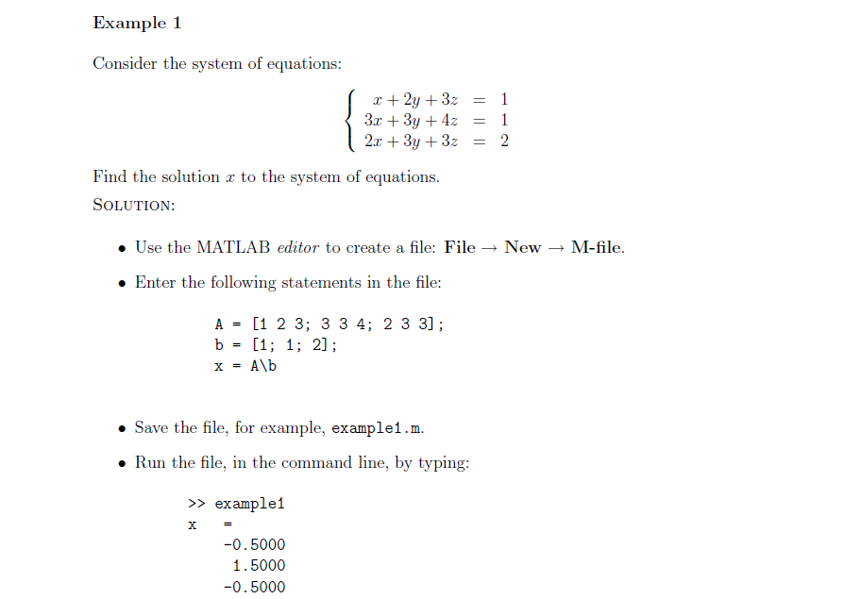
M-File Scripts

Slide 38
Create a file, say example2.m, which contains the following commands:
x = 0:pi/100:2*pi;
y1 = 2*cos(x);
y2 = cos(x);
y3 = 0.5*cos(x);
plot(x,y1,'--',x,y2,'-',x,y3,':')
xlabel ('0 \leq x \leq 2\pi')
ylabel ('Cosine functions')
legend ('2*cos(x)','cos(x)','0.5*cos(x)')
title ('Typical example of multiple plots')
axis ([0 2*pi -3 3])
Run the file by typing example2 in the Command Window.

Slide 39
